Slide 1
Correlation
LEcture

Slide 2
Correlation and demographics
Correlation
Statistics and data science are often concerned about the relationships between two or more variables (or features) of a dataset. Each data point in the dataset is an observation, and the features are the properties or attributes of those observations.
Every dataset you work with uses variables and observations. For example, you might be interested in understanding the following:
How the height of basketball players is correlated to their shooting accuracy
Whether there’s a relationship between employee work experience and salary

Slide 3
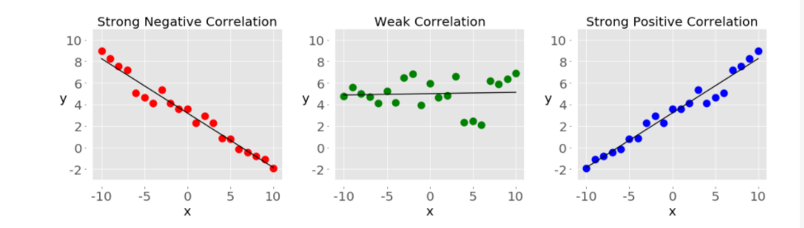
Correlation and demographics

Slide 4
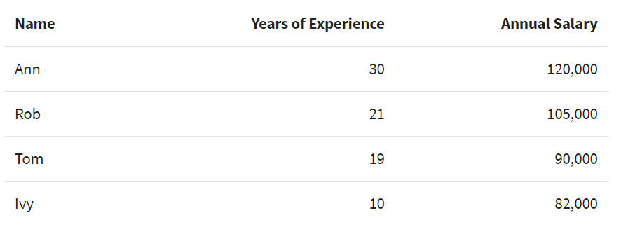
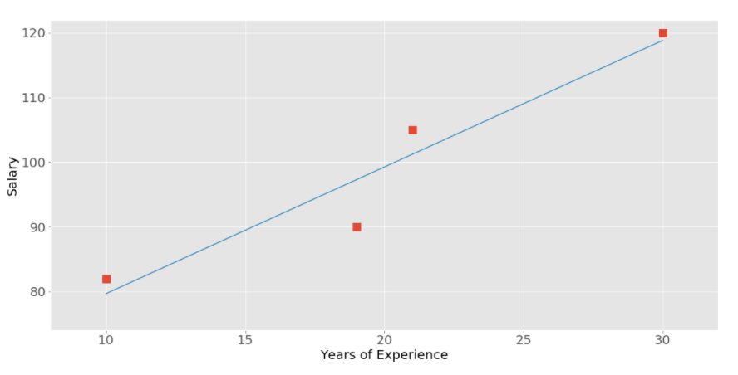

Slide 5
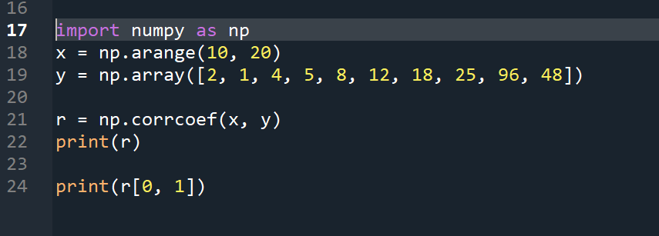
Calculting correlation values thorugh coding - Numpy
Calculating Through Numpy Library

Slide 6
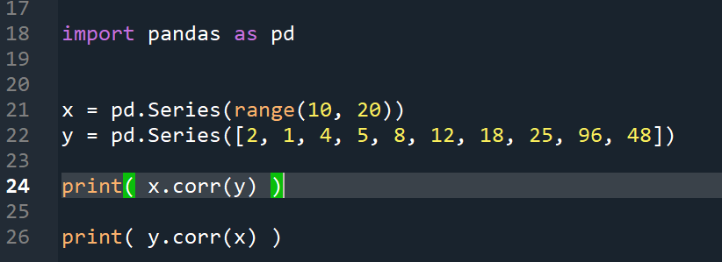
Calculting correlation values thorugh coding - pandas
Calculating Through Pandas Library

Slide 7
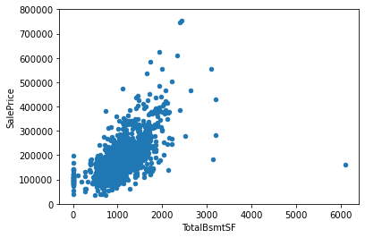
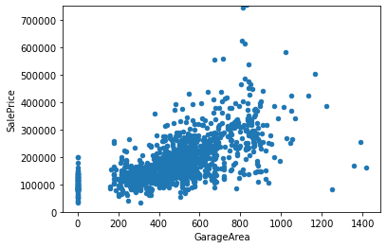
Displaying the relationship graphically

Slide 8

Links and sources
https://stackabuse.com/calculating-pearson-correlation-coefficient-in-python-with-numpy/
https://machinelearningmastery.com/how-to-use-correlation-to-understand-the-relationship-between-variables/
https://realpython.com/numpy-scipy-pandas-correlation-python/

